Slide 1
Running a digital collection day in 4 steps
Stuart Lee
Ylva Berglund Prytz
ww1collections@it.ox.ac.uk

Slide 2
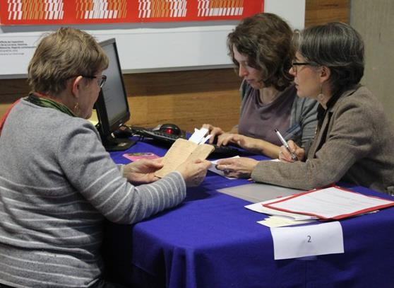
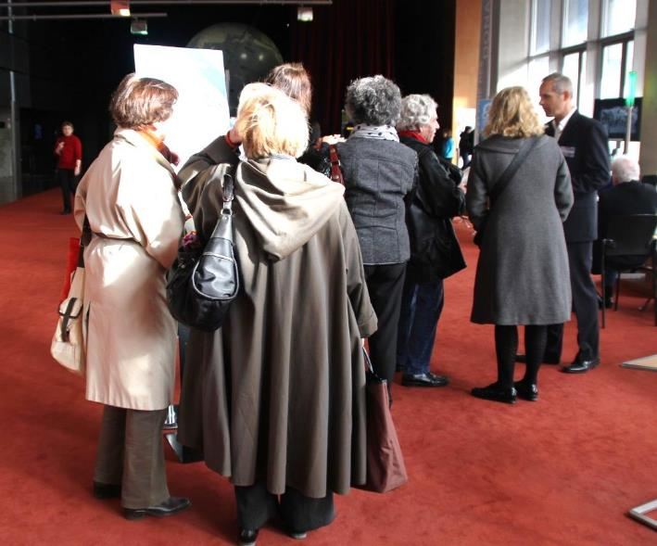
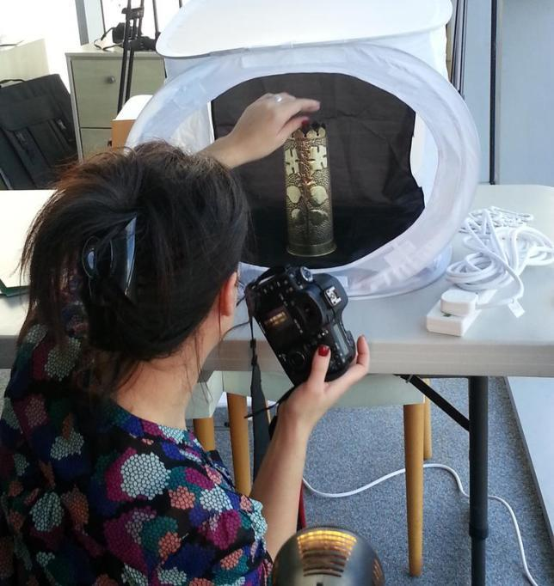
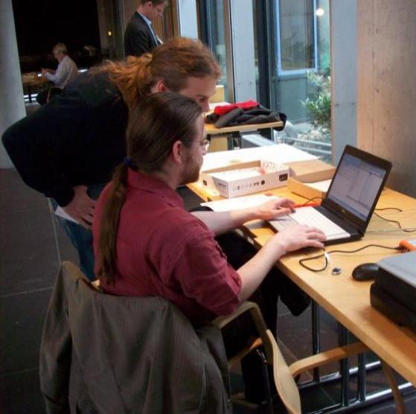
2. Interview & Record ‘story’
1. Welcome people
4. Upload to website
3. Digitise objects
Notes:
Quick overview. What is a roadshow?

Slide 3
Or …
1. Welcome
2. Interview
3. Digitise
4. Upload
On the day
After the day (?)

Slide 4
Video: What is a digital collection day?

Slide 5
THINK: BBC’s Antiques Roadshow with digital cameras!

Slide 6
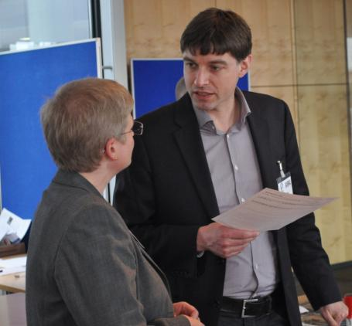
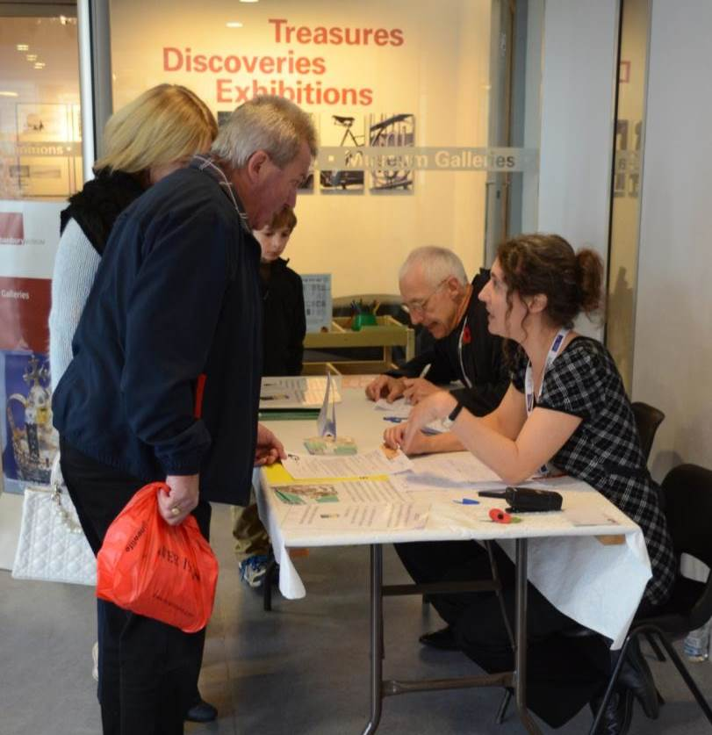
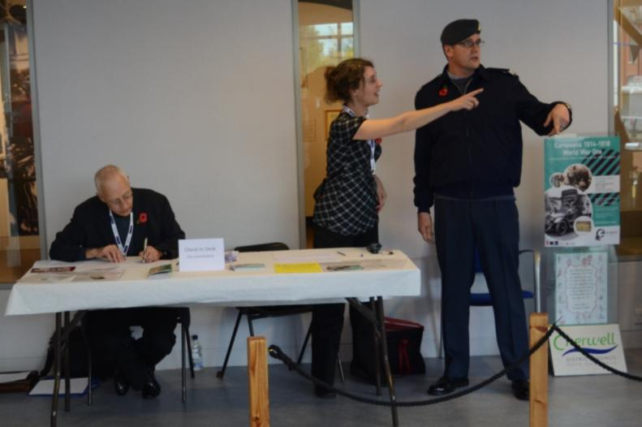
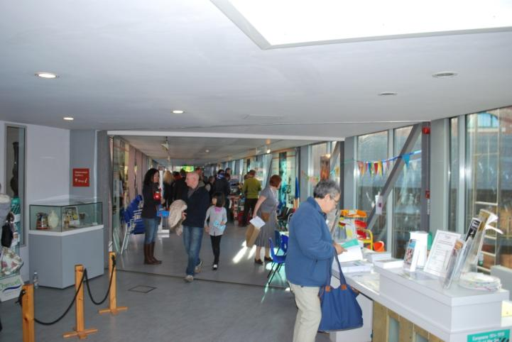
1. WELCOME DESK
First stop for visitor
Welcome

Slide 7
Welcome Desk: What does it do?
Collects basic information
Signs permissions form
Organise and manage queue, waiting area, tea …
Who do you need?
Desk staff
‘Meet and greet’
Queue manager/MC
Welcome

Slide 8
What is the permissions form?
A form the contributor needs to sign agreeing they:
have the right to share the material they have brought in
are happy for others to see and re-use the digital version
as long as they say where it came from (‘attribution’)
Welcome

Slide 9
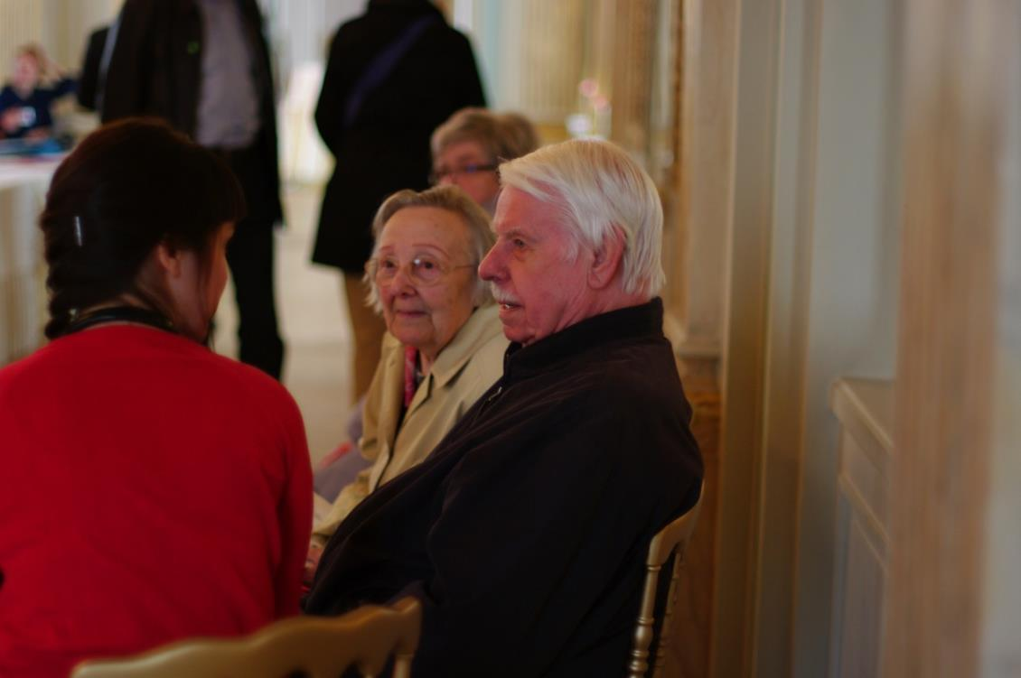
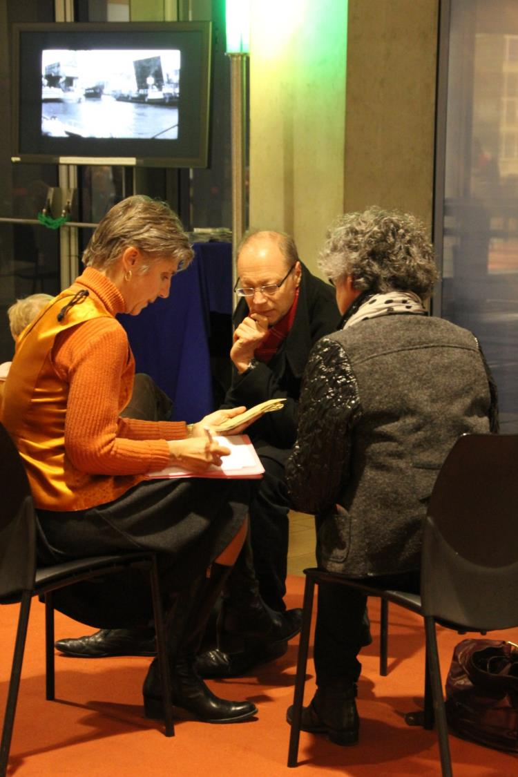
“MEET AND GREETERS” - help with the form - answer questions - keep people happy
Welcome

Slide 10
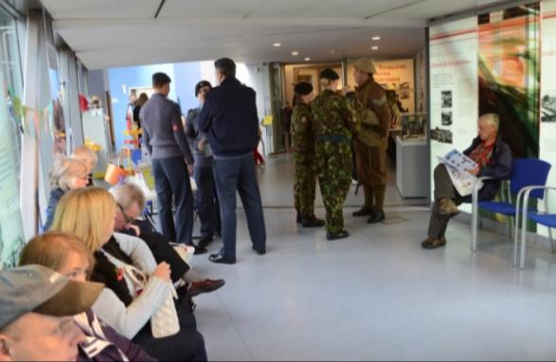
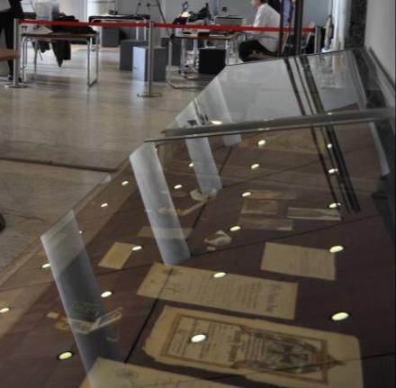
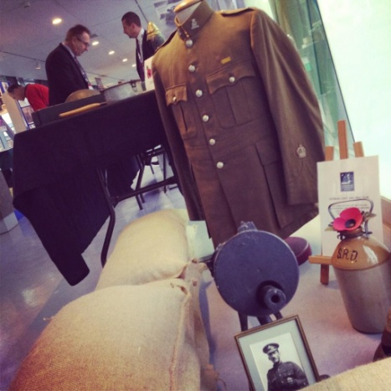
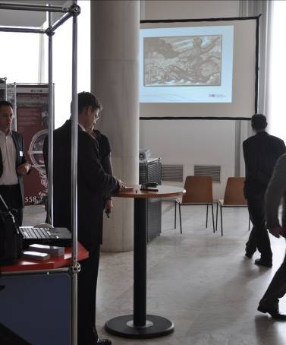
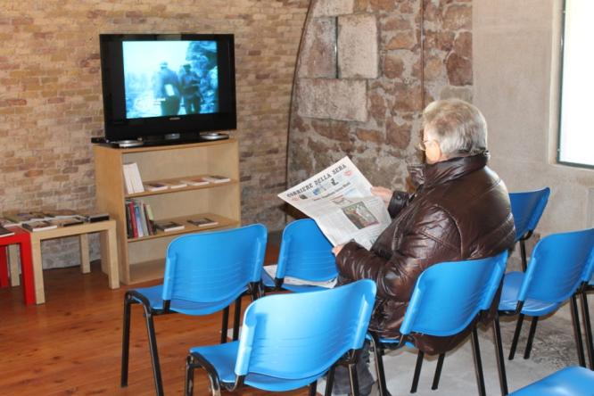
Public areas
D

Slide 11
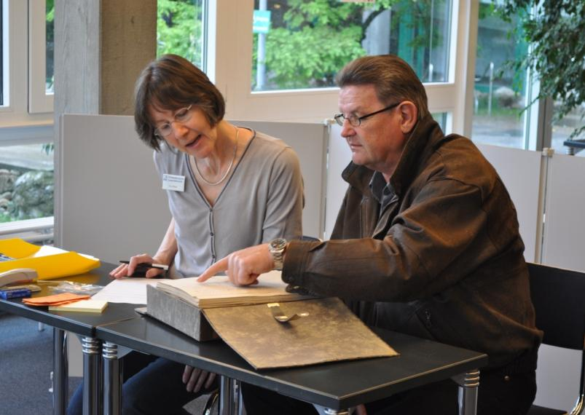
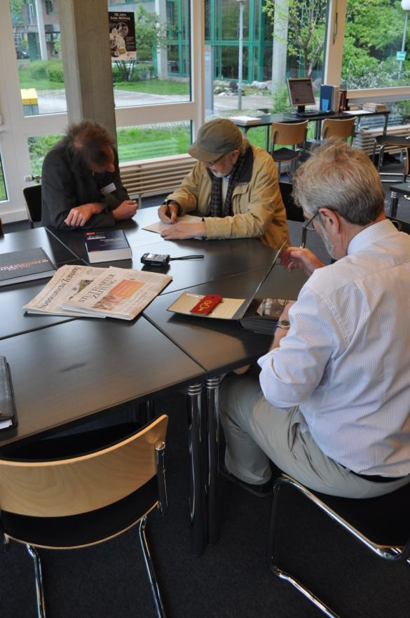
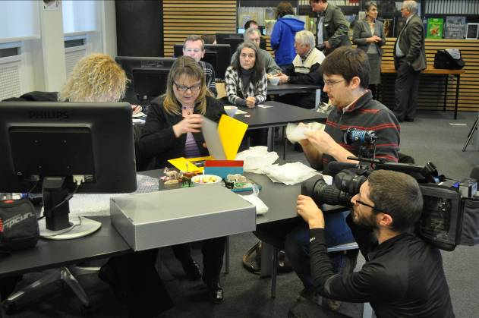
Welcome desk then takes visitor to
2. INTERVIEW
Interview

Slide 12
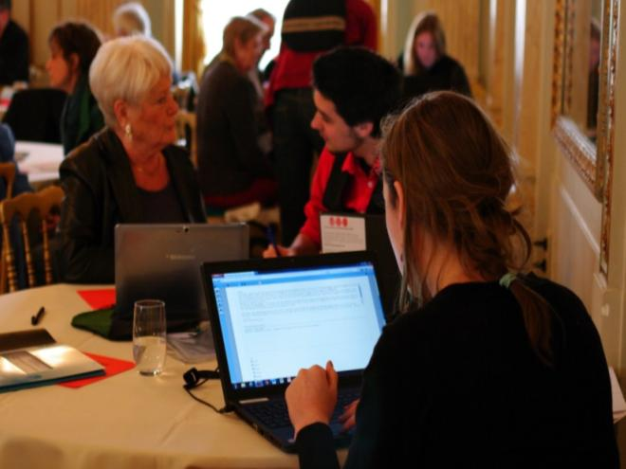
Interview: What happens?
Who do you need?
Interviewer
‘Scribe’
(Subject expert)
Check permission form
Record story and information
Selects key items
‘Label’ all objects
Interview

Slide 13
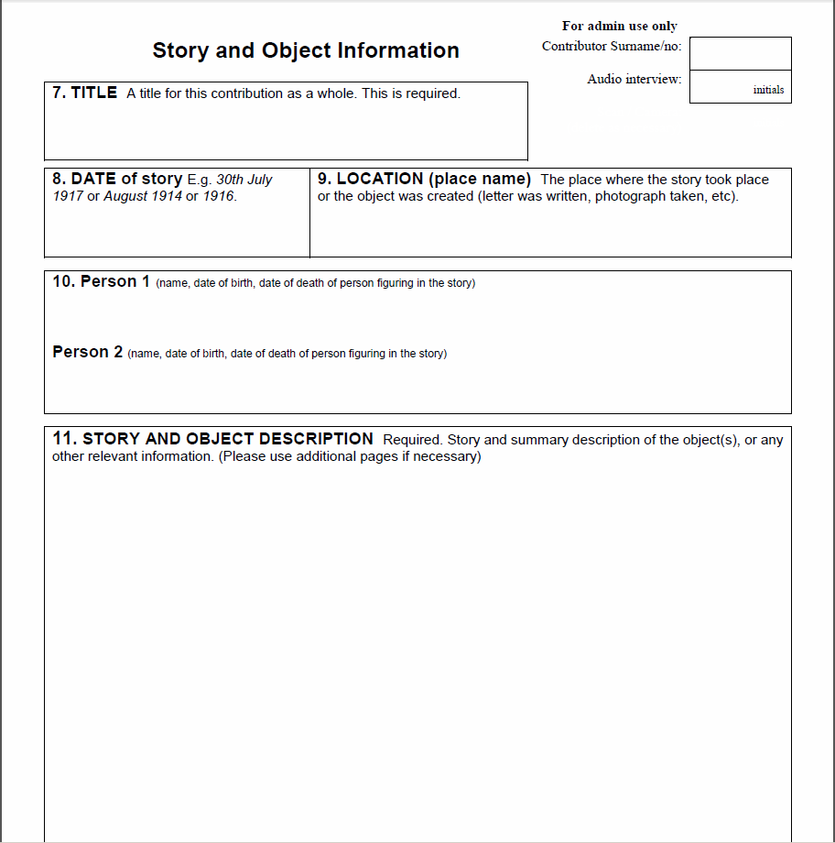
Interviewer talks to contributor and scribe records details (write down or type in)
A Stretcher-bearer at Gallipoli
April 1915
Gallipoli
Ltn Joe Smith (1894-1970)
Ltn Smith did this and this happened and this is how we know and how the objects ended up where they are…
Interview

Slide 14
THE STORY
Anything relevant to period of WW1
About person, event, place, object
Extract ‘story’
Record related information
Names, dates, places
Relationship to contributor
Other information
Write readable prose (possibly later)
Interview

Slide 15
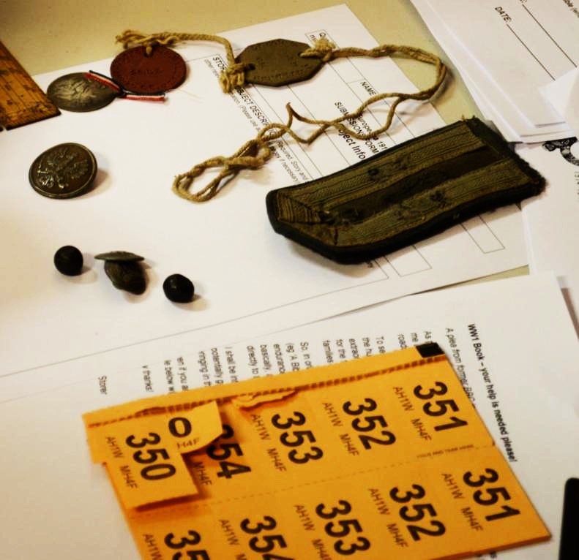
THE OBJECTS
Interviewer gives each object/set of objects one number.
351 : Three buttons
352 : Medal
353 : Dog tags
354 : 10 postcards
Interview

Slide 16
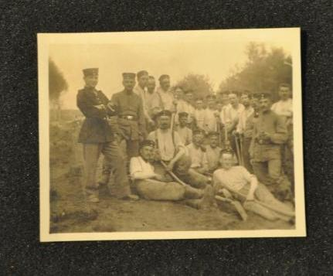
Each object is described (on paper or computer) ….
A Stretcher-bearer at Gallipoli
April 1915
Gallipoli
Ltn Joe Smith (1894-1970)
Ltn Smith did this and this happened and this is how we know and how the objects ended up where they are…
OBJECTS:
Group photo of Ltn Smith and friends
Dogtag on string, belonged to Smith
Five letters from Smith to his sister
Interview

Slide 17
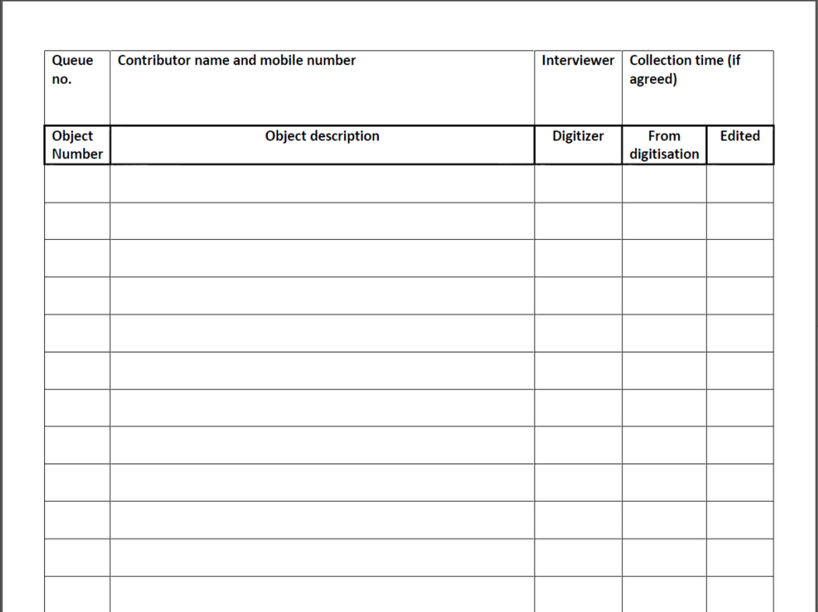
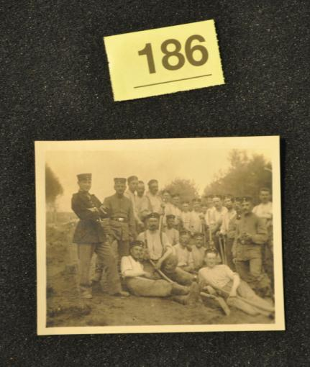
… and recorded on object list (one list/contributor)
28 John Smith 0791 1234 5678 ABC
Group photo
Dog tag
Letters (5)
Object number
Interview

Slide 18
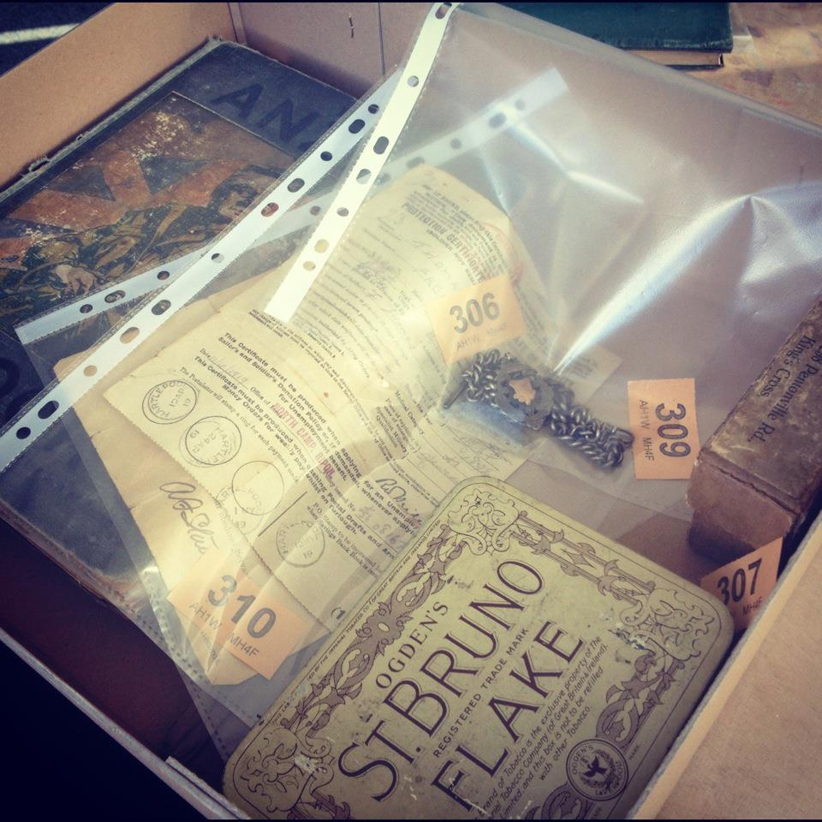
Each object is placed with its number in folder, or similar, and all put in box/tray.
Keep objects and list together (one box and list per owner).
Interview

Slide 19
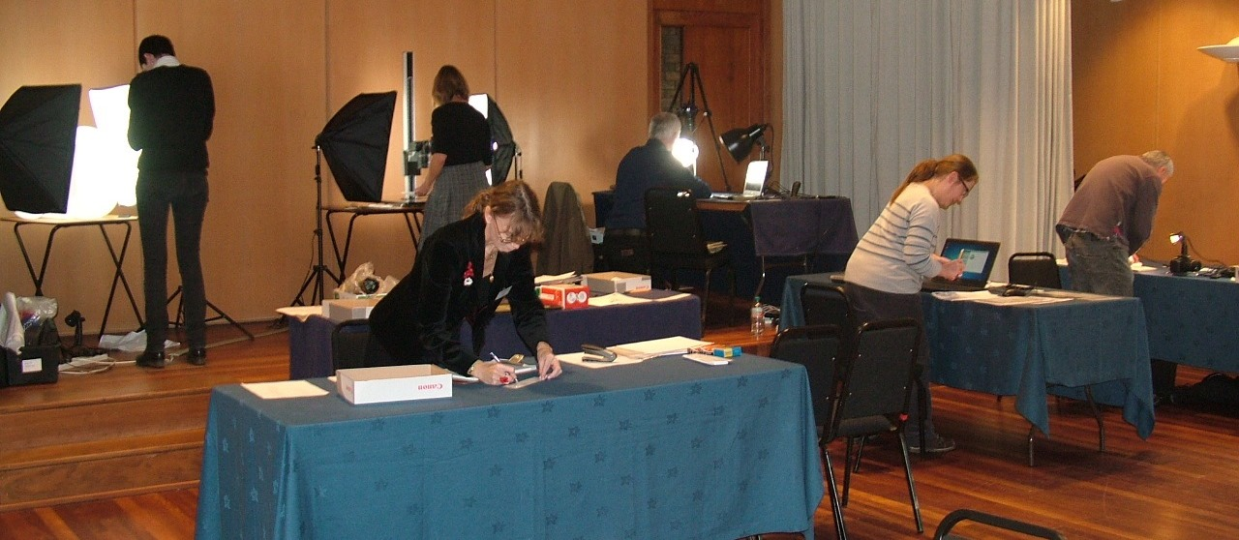
Interviewer then takes objects and paperwork for
3. DIGITISATION
(Digitisation Desk and Digitisation Stations)
Digitisation

Slide 20
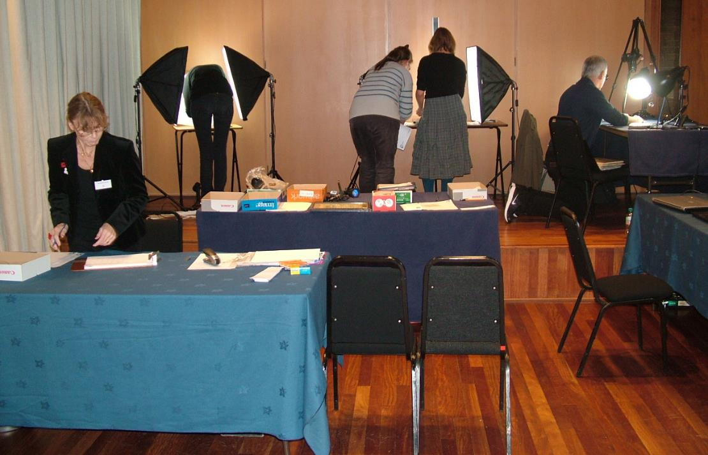
Digitisation Desk: What happens?
Check in objects
Hand to digitisers
Digitise
Check out/ Return to owner
(Back up memory cards)
Who do you need?
Check-in/out
Helper
Co-ordinator
(Back-up)
Digitisation

Slide 21
28 John Smith 0791 1234 5678 ABC
Group photo
Dog tag
Letters (5)
Scan 1
Cam 1
Cam 2
Desk staff or digitiser makes note on list about where objects are being digitised
Digitisation

Slide 22
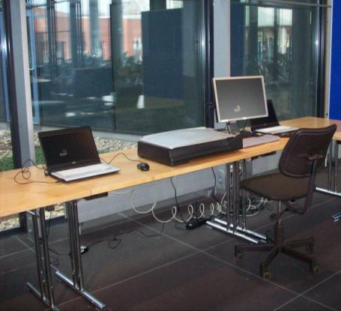
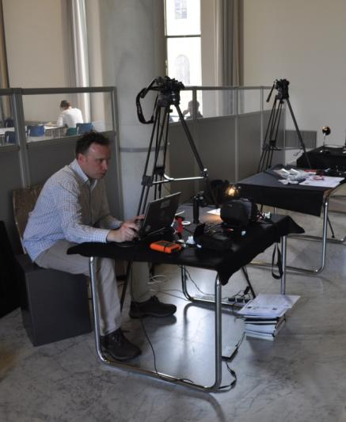
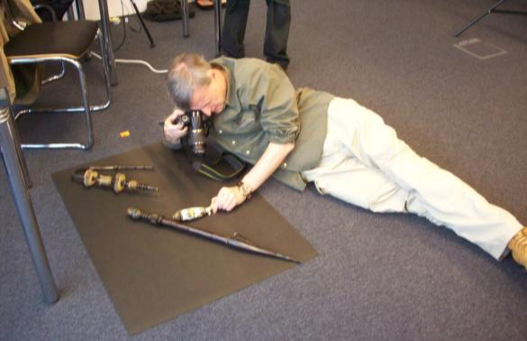
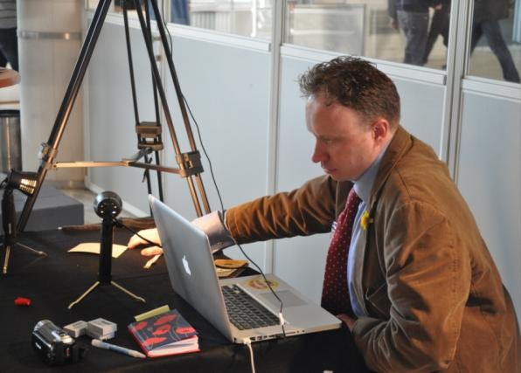
Digitisation Station(s): What do they do?
Take digital image of objects
Back up memory cards
Digitisation

Slide 23
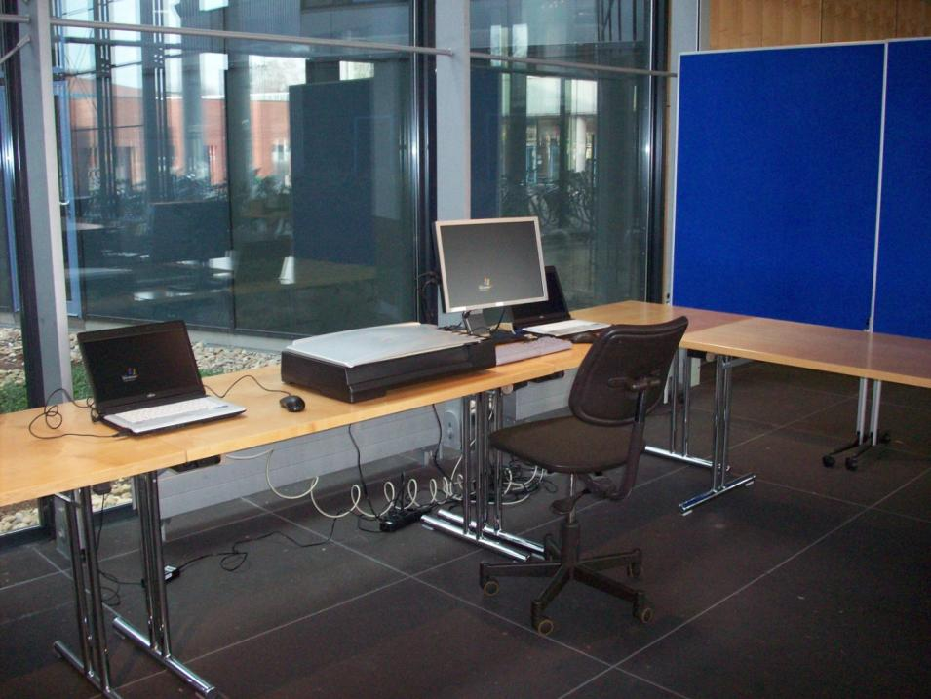
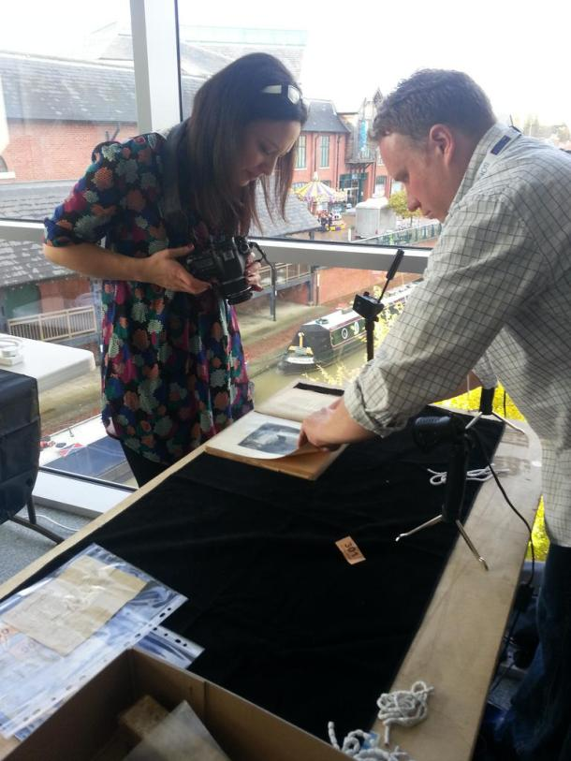
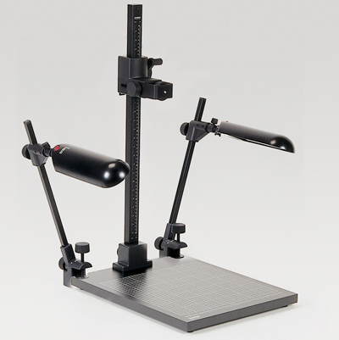
Scanning or Digital Cameras?
Good for papers, faint print, flat objects.
BUT SLOW…
Can be used for all kinds of objects
Fast, flexible
Digitisation

Slide 24
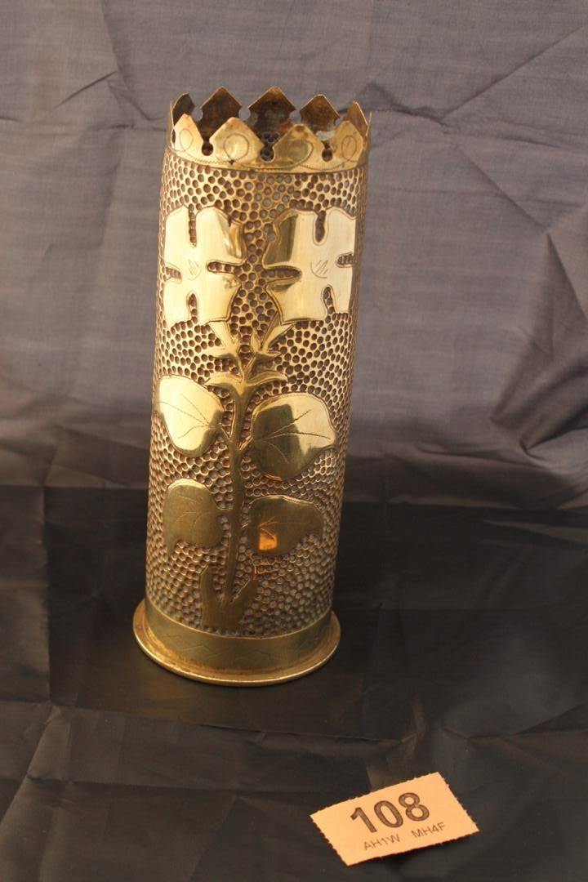
Take first picture with ticket
Digitisation

Slide 25
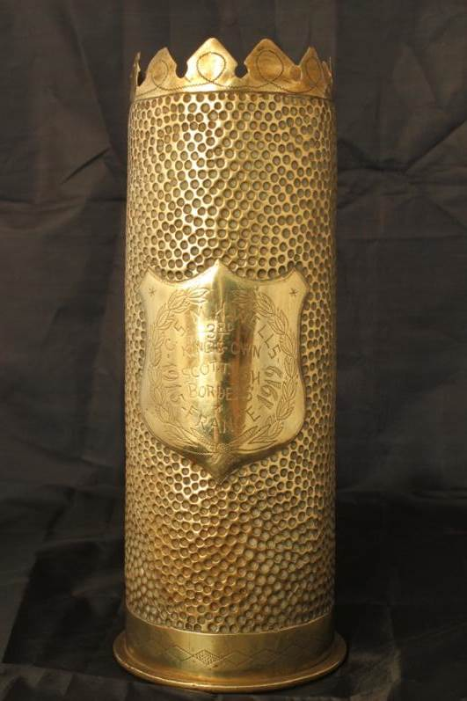
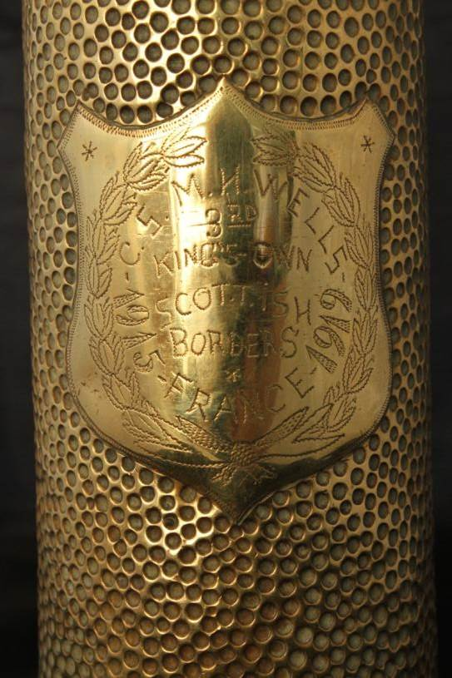
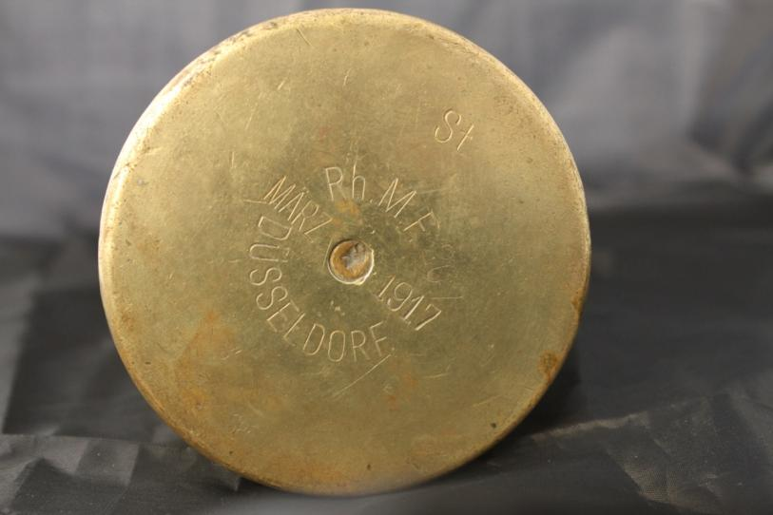
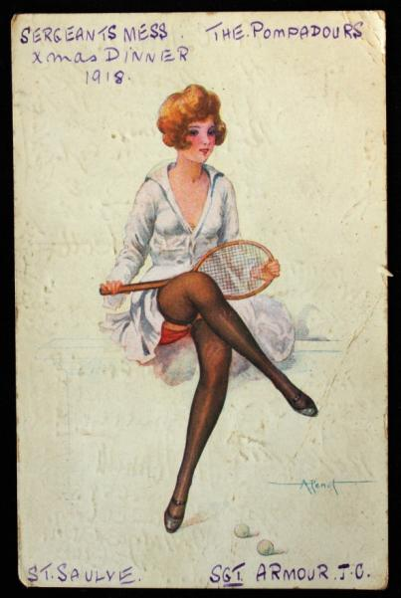
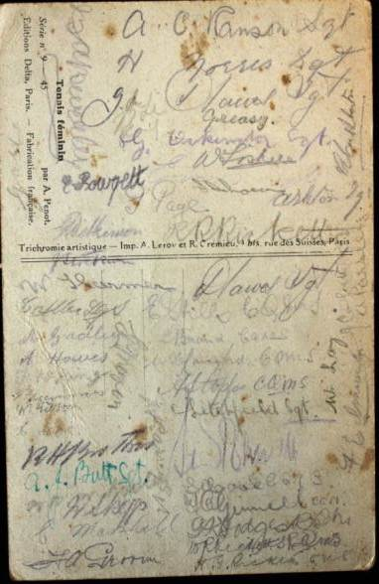
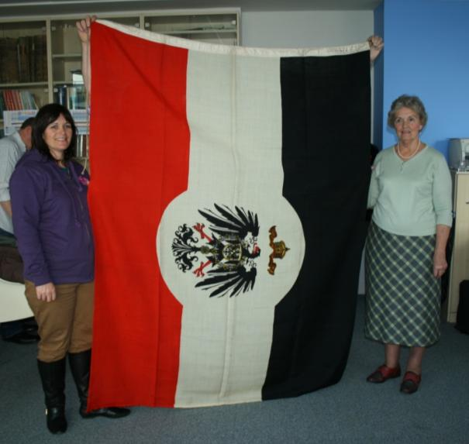
Take several pictures of each object
Capture front/back
Be flexible
Digitisation

Slide 26
28 John Smith 0791 1234 5678 ABC
Group photo
Dog tag
Letters (5)
Scan 1
10.12
Cam 1
10.05
Cam 2
10.12
Note when objects have been digitised
Take objects to the ‘Returns desk’
Digitisation

Slide 27
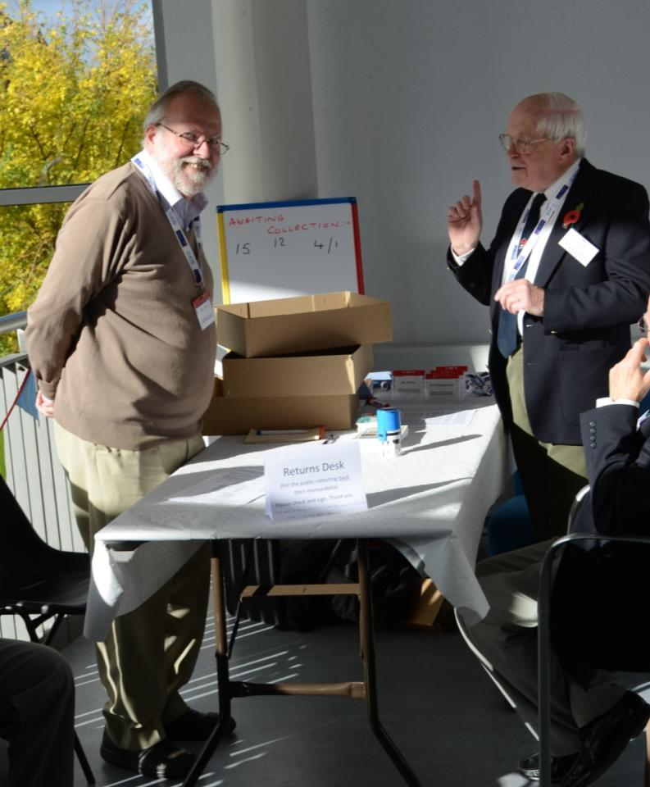
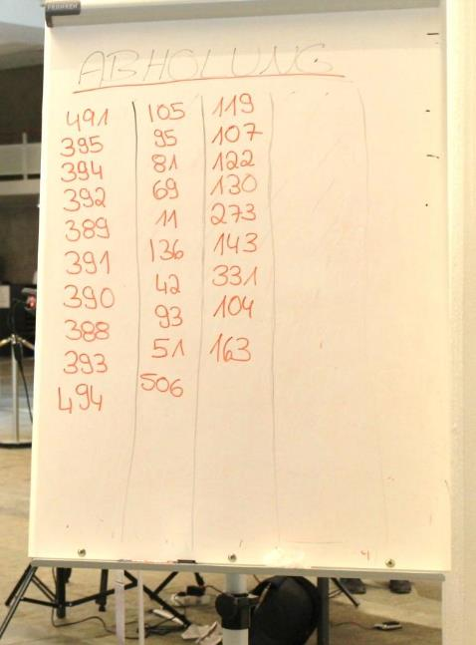
RETURNS DESK?
Check that all objects are processed.
Notify owner.
Owner signs list

Slide 28
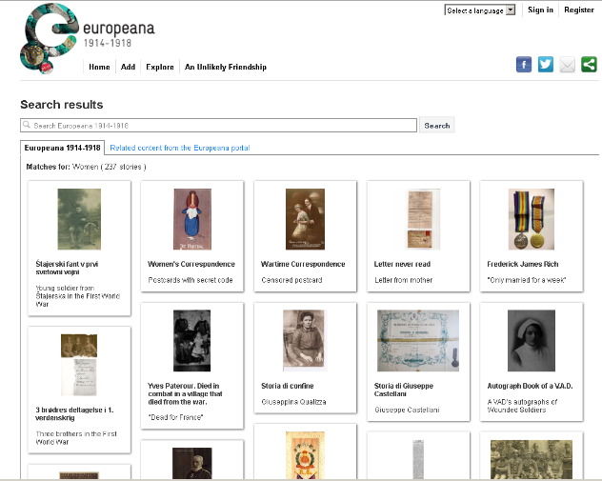
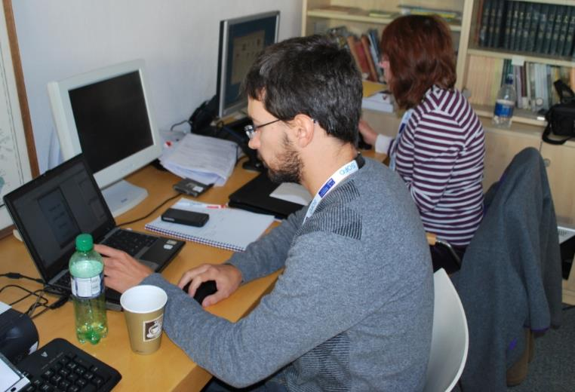
4. UPLOAD (After event!)
Edit images and stories
Link images to right story
Upload story and image(s) to online platform
Archive originals and final versions
Who do you need?
Cataloguers
Image editors?
Upload
Notes:
In some ways, work begins after the event. Make sure material is post-processed and uploaded. Also lots of attention.

Slide 29
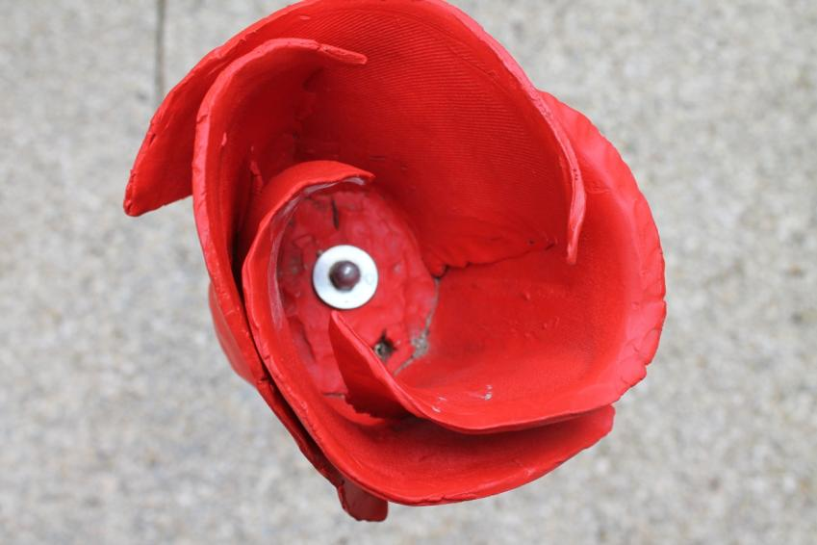
Also think about
Visitor experience
Security
Lead up to the event - promotion

Slide 30
Putting it all together?
Welcome
Interview
1. Welcome Desk
2. Interview Desk
2+ people (1 Welcome Desk, 1+ Meet and Greet)
1 Queue Manager
1 MC
Permissions Forms
3 interview desks (2 people on each, ‘interviewer’ and ‘scribe’)
1+ subject experts
‘Story’ forms (paper or computer)
Object Lists
Raffle Tickets
Folders and trays

Slide 31
Putting it all together?
Digitisation
Upload
3. Digitisation
4. Upload
2+ for Digitisation Desk
In/Out tables
3+ digitisation stations : 2 cameras, 1 scanner (2 people on each, ‘photographer’ and ‘helper’)
2 cameras, tripods, lights, laptops, etc
Flash cards for camera
Scanner with laptop
Returns desk (1+ )
1+ cataloguer
Computer with internet connection
All stories, images and paper forms

Slide 32
Summary
Welcome: 2+ students, 1 Staff
MC: 1 Staff
Interview: 6+ students, 1 Staff, 1+ Subject Expert
Digitisation Desk: 2+ students, 1 Staff
Digitisation Stations: 6+ students
Returns desk: 1 student, 1 Staff

Slide 33
And…
Stephen Barker and David Alton
SunDog TV Documentary
Commonwealth War Graves Commission (CWGC)

Slide 34
PREPARATION & Troubleshooting

Slide 35
Check-lists, guides, forms - for your support
Adapt to your event and your needs
ASK US!!!

Slide 36
What to do if…
… too many people come?
… too few people come?
… there is too much to digitise?
… there are problems with equipment?
Other issues?
How to avoid problems?

Slide 37
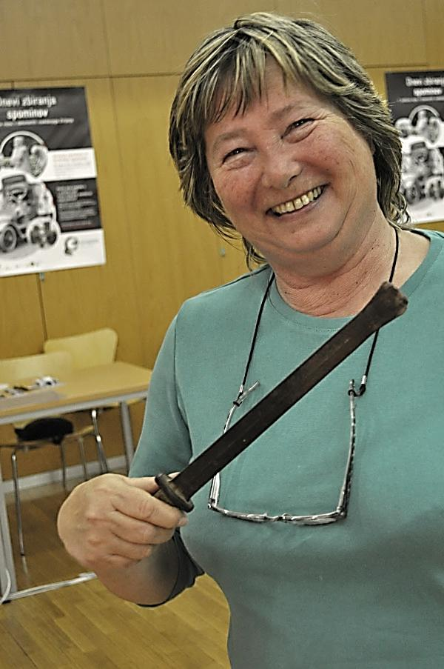
Questions? Discussion

Slide 38
Running a digital collection day in 4 steps
Stuart Lee
Ylva Berglund Prytz
ww1collections@it.ox.ac.uk

